Slide 1
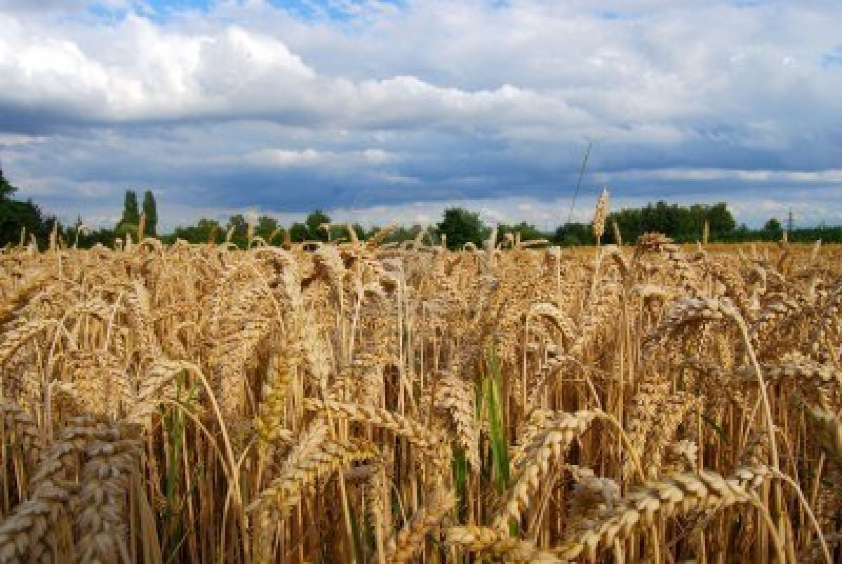
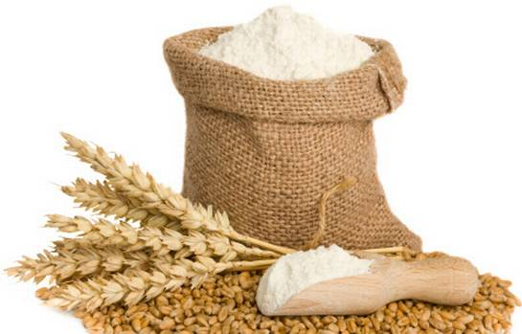
From Wheat to Table

Slide 2
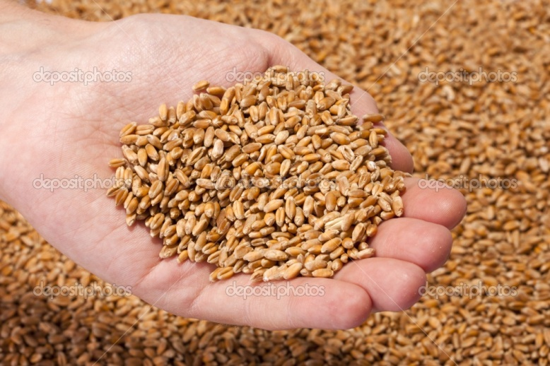
Table of Contents
A farmer plants the wheat page 3
A harvester cuts the wheat page 4
A truck driver takes the seeds to the mill page 5
A miller makes the flour page 6
A baker makes bread pages 7-8
A clerk sells the bread page 9
A shopper buys the bread page 10
We all eat the bread page 11

Slide 3
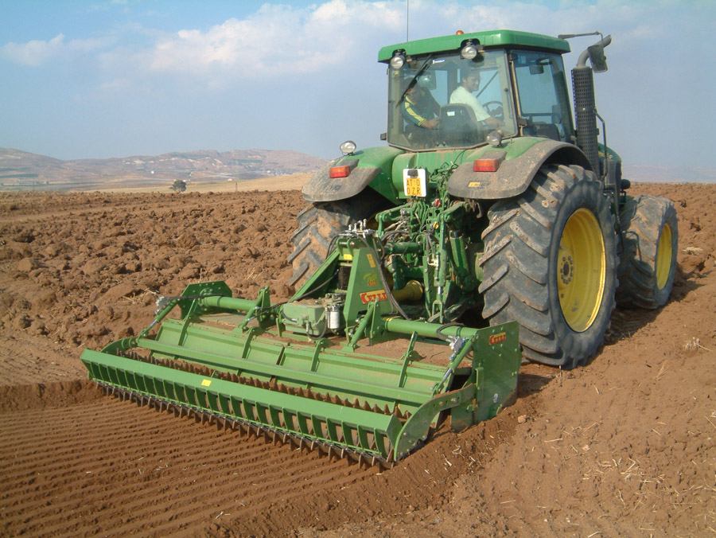
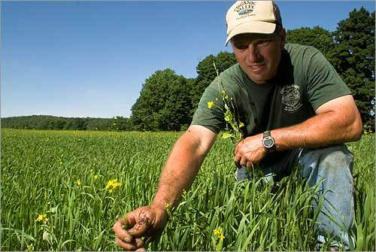
Who plants the wheat?
A farmer uses a tractor to plant his wheat.
The seeds need sun and rain to them grow into plants.
When the plants are ready they turn golden.

Slide 4
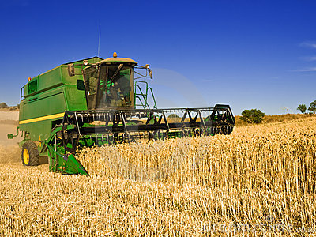
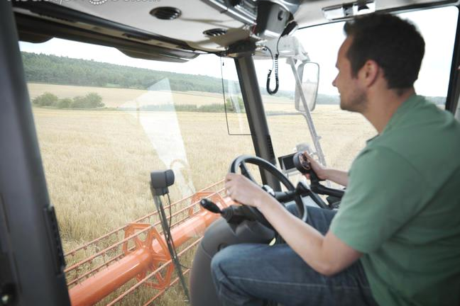
Who cuts the wheat?
A harvester cuts the wheat with a combine.
A combine does two jobs.
It cuts the wheat and separates the seeds.

Slide 5
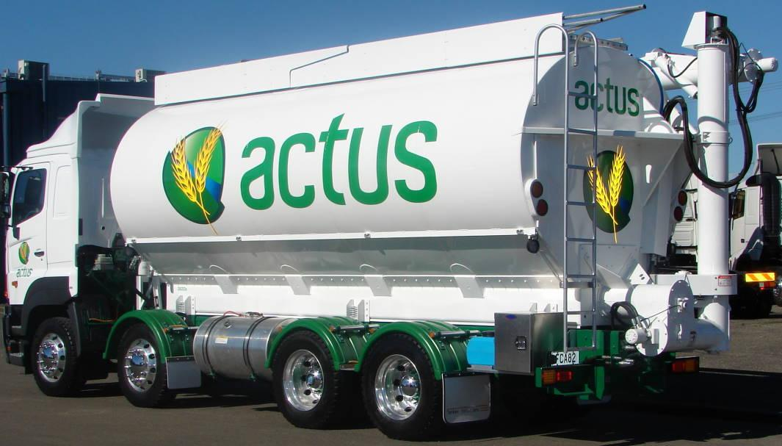
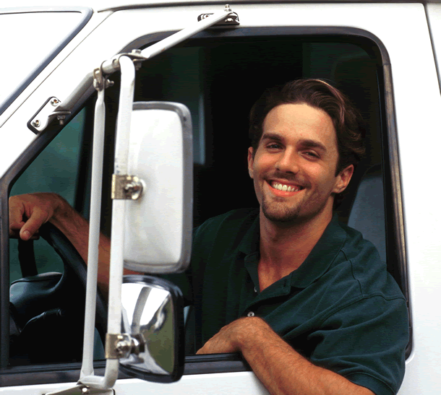
Who takes the seeds to the mill?
A truck driver takes the wheat seeds to the mill.
Wheat seeds are called kernels.

Slide 6
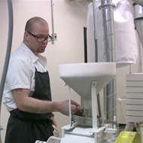
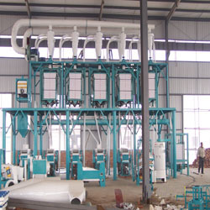
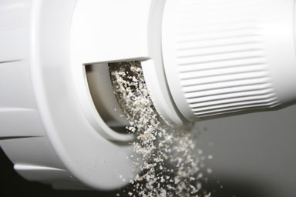
Who makes the flour?
A miller uses a machine to grind the kernels.
Then, they are sifted into powder.
The powder is called flour.

Slide 7
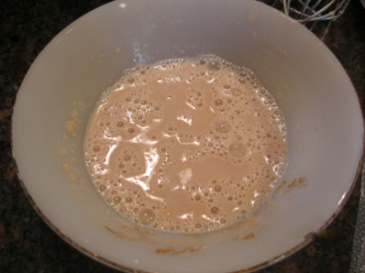
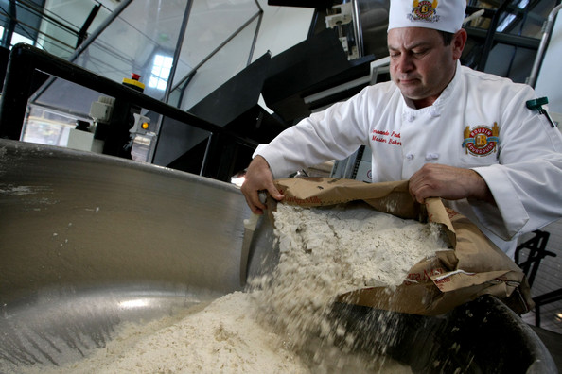
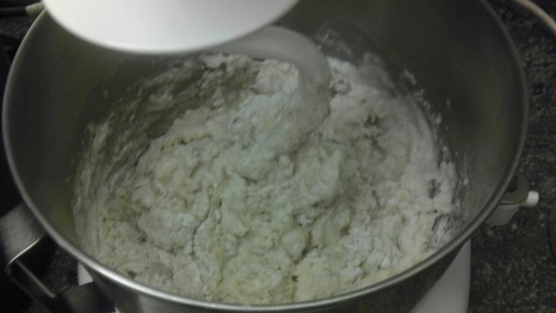
Who uses the flour to make the bread?
yeast with water
Bakers use flour to make bread.
First, they make dough by mixing flour, butter, water and yeast.
The yeast makes the dough rise.

Slide 8
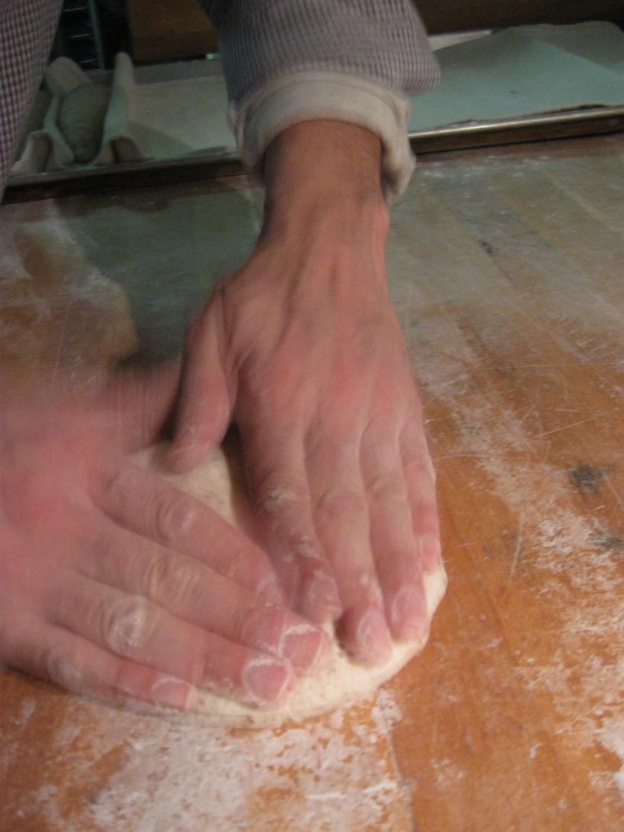
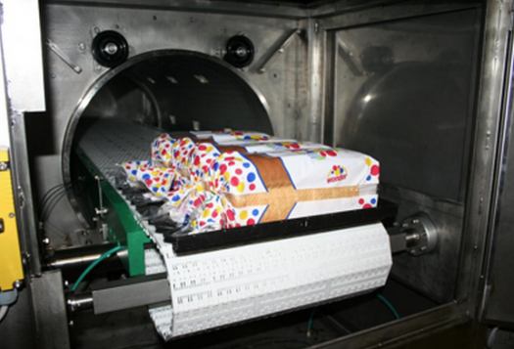
The baker shapes the dough and bakes it in the oven.
Now it is bread.
It is wrapped and ready for market.

Slide 9
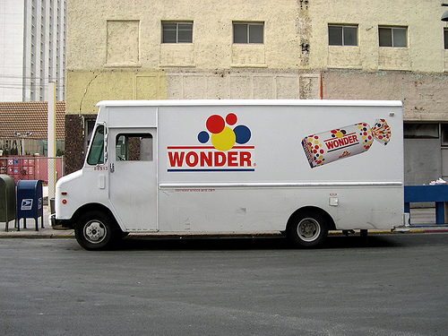
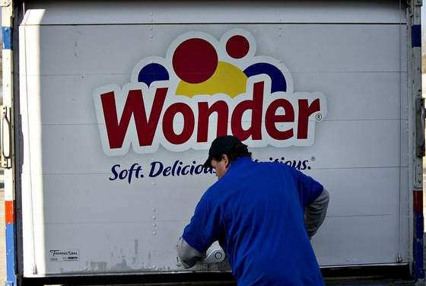
Who sells the bread?
A driver takes the bread to the market.
The clerk at the market sells the bread.

Slide 10
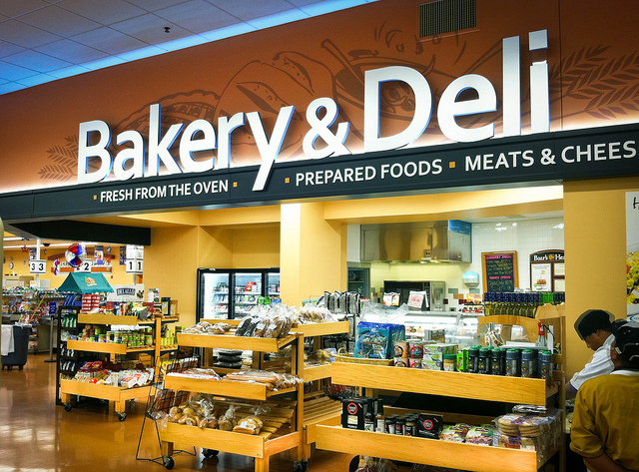
Who buys the bread?
Shoppers buy the bread.

Slide 11
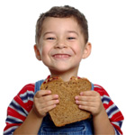
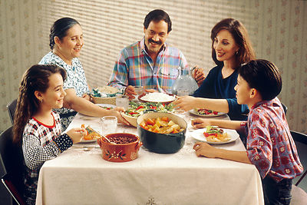
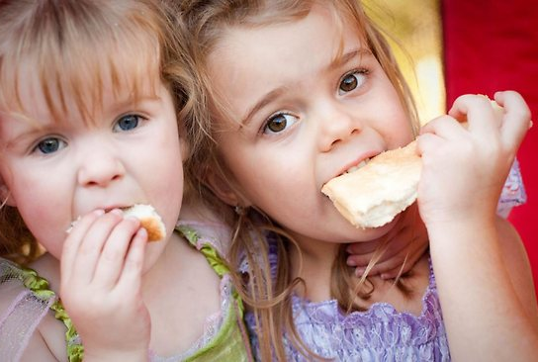
Who eats the bread?
We eat bread at our table.

Slide 12
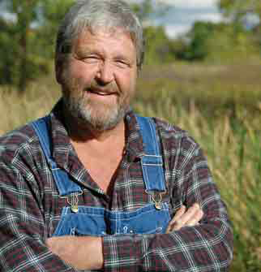
as
Relating Factor: helps with the bread by

Slide 13
as
Relating Factor: helps with the bread by

Slide 14
as
Relating Factor: helps with the bread by

Slide 15
as
Relating Factor: helps with the bread by

